Slide 1

Hastings & Rother Arts Education Network Meeting
7th October 2014 at the DLWP

Slide 2


Slide 3
The aims of the festival
To entertain with ‘world class’ performances
To be inclusive, all genres of music for all ages
To encourage young people to participate and love music – all genres
To assist teachers in delivering

Slide 4
Education
Commissioned new piece of music.
5 schools participating
Performance at De La Warr on 16th October
Artists from Glyndebourne and London Philharmonic Orchestra will assisting in coaching
Builds team work, confidence, access to music , enjoyment.

Slide 5
Master Classes
Available to songwriters , bands and musicians.
Mentored by Radio 1 and 6 , Record Labels , producers and local stars – Tim Rice Oxley (Keane)
Enable young people to learn how the Music Industry works

Slide 6
Opera in a day
Up to 30 children
Write and perform an Opera in a day
Glyndebourne provide:
Singers – Producers – choreographers
Opera performed on the day

Slide 7
2015 onwards
Looking to work further with Schools in the area and further develop lasting relationships

Slide 8
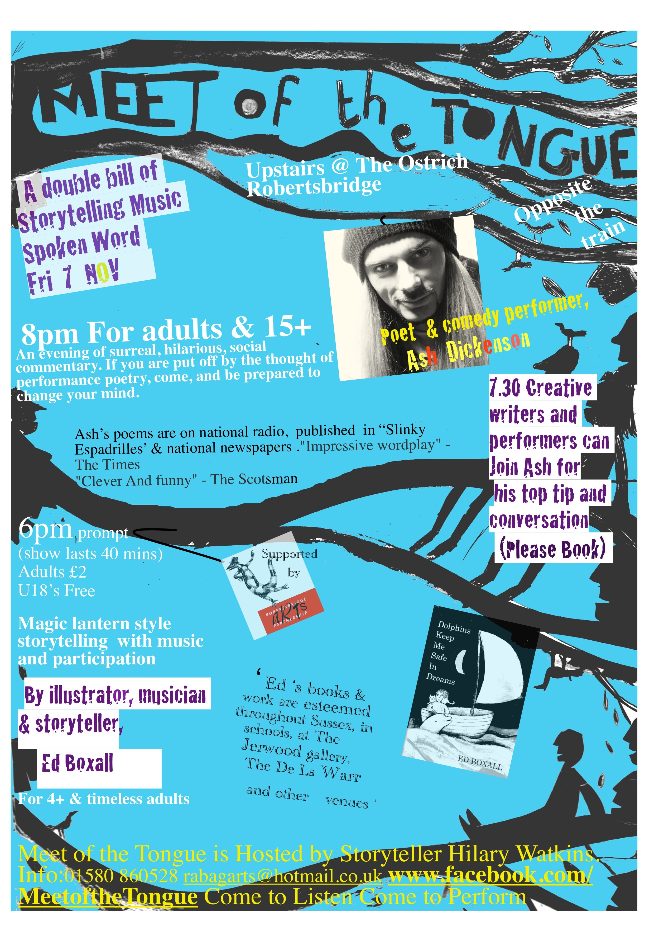
Meet of the
Tongue
Meet of the Tongue is a contemporary ceilidh. The tradition has no clear line between audience and performer and provides a generous and eclectic space for young adults to perform alongside top level visiting professionals in the three art forms and local regular performers who include students from Pestalozzi International village.

Slide 9


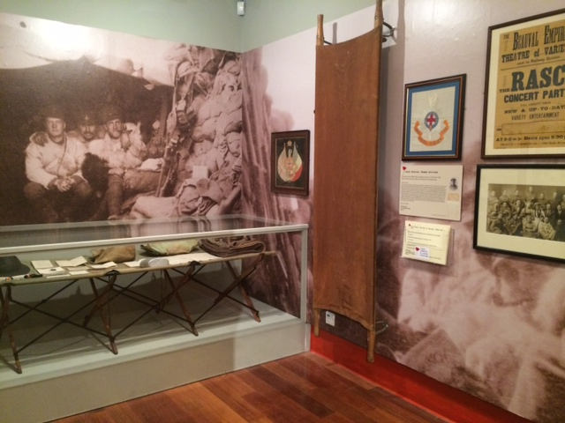

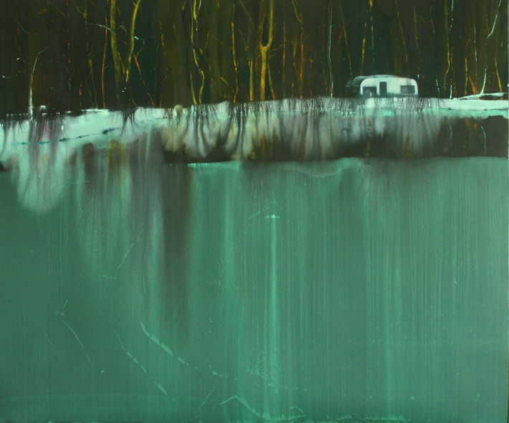

On now & coming up …
Exhibition until16 November 2014
Free workshops
Free Workshop facilitation training
More project activities planned for 2015, especially looking at women’s histories
‘The Eyes Are Listening’ : Exhibition of paintings by six contemporary artists based in Sussex
Tom Hammick, Andrzej Jackowski, Kathe Deutsch, Nick Archer, Gus Cummins RA & Matthew Burrows
29 November – 22 February 2015
For info & enquiries, email charvey@hastings.gov.uk

Slide 10

Culture Shift
Arts Award Forum Event for Independent Practitioners
Monday 13 October 2.00-4.00pm at Jubilee Library, Brighton
Arts Award Training – all at Lighthouse, Brighton
Friday 17 October Gold Top Up
Friday 5 December Bronze and Silver
Friday 12 December Discover and Explore
Limited places on in-house training
14 October Discover and Explore; 4 November Bronze and Silver
Artsmark Training – Opportunity to run bespoke course for HRAEN?

Slide 11





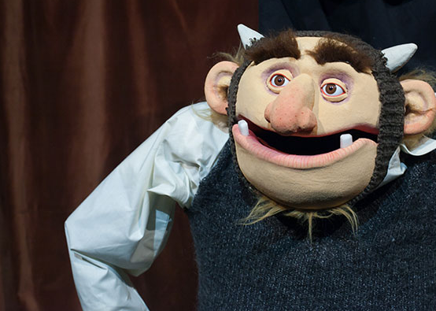
Supported by the European Union
Hastings Storytelling Festival : Global Learning CPD
A week long festival of stories (10-16 November) for children and adults told in venues across the town by outstanding storytellers.
2014 programme includes:
Fireside Tales with Grandad (Pickled Image Theatre Co)
Children’s Parade and Children’s Day: Free artists workshops
Velvet Curtain (Adult storytelling/cabaret)
A free (1-2 hour) CPD opportunity for teachers on Wednesday November 12th, with professional storytellers (Islamic theatre co - Khayaal), will explore how storytelling can be used to develop global awareness and breakdown social prejudices caused by a lack of understanding, such as Islamophobia.
What does Global
Learning Cover?
Global citizenship
Conflict resolution
Diversity
Human rights
Interdependence
Social justice
Sustainable development
Values and perceptions

Slide 12
Supported by the European Union
Register your school for Global Learning Programme
Free Global Learning CPD courses are available from 18 Hours.
Your school gets 500 e-credits to spend on CPD by signing up to the Global Learning Programme.
Signing up for the Global Learning Programme is quick and easy. You will conduct a quick (15 minute) online audit to assess the level to which Global Learning is currently embedded in your school. Go to www.globaldimension.org.uk to register.
18 Hours can come to your school and deliver CPD at a time that suits you and your colleagues.
If there is sufficient demand we can run shared sessions for a group of schools.
  How do you teach stories from global cultures responsibly?
  Whole team approach to Global Learning, with Global Teacher Award
  Global learning with a focus on environmental sustainability
  Teaching whole school themed weeks (e.g. Africa, Environment,
  International)
  How do you teach about Africa?

